Slide 1
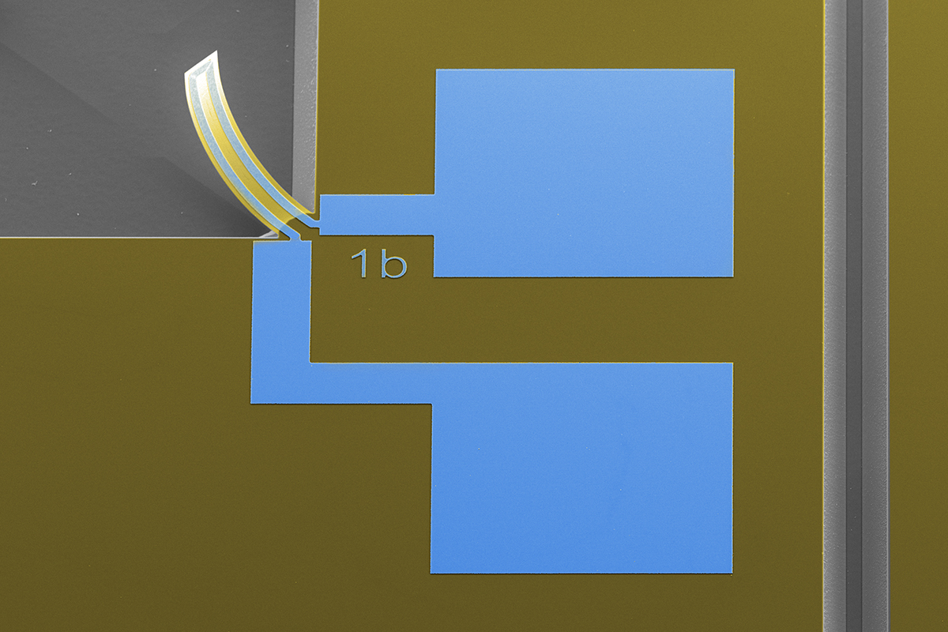

Thermal microactuator
-- Theory
MICRO-373 Advanced microfabrication practicals
Spring semester - 2024
1st session theory
Notes:
Cover page, no text spoken

Slide 2

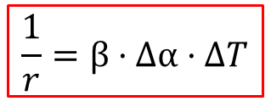
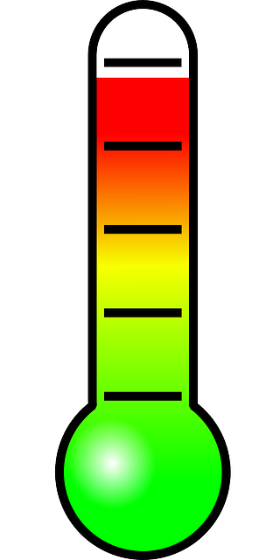


Physical principles of a bi-morph
Y
Bi-morph
Thermal expansion induces bending
Static and dynamic behavior
Material 1
Material 2
X
σ: strain [Pa]
E: Young’s modulus [N/m²]
α: thermal expansion coefficient [K ⁻¹]
ΔT: temperature difference [K]
r: radius of curvature
t: thickness [m]
β: constant, f(t, E)
Notes:
The physical actuation principle of a bimorph is based on the controlled mismatch in expansion or shrinkage of two complementary materials when the temperature changes. In fact, every material has its own specific thermal expansion coefficient with quite large variations. Such a device is also called bi-morph, from the Latin word: bi for 2, and the Greek word morph for shape. In the case when the two materials are metals, it is called a bi-metal. Depending on the application in mind one has to consider both the static and dynamic properties of the device.
To show the effect of the thermal expansion, two configurations are shown as illustration on the bottom of the slide.
On the left side, the two films of different material are not in contact. Hence they can expand freely when the temperature rises. (show animation)
On the right side, the two films are in close contact, they are bonded or glued together, so that they cannot slide at the interface. In this case, the difference in the expansion of the two materials induces a bending of the freestanding cantilever beam. (show animation)
In the lecture notes you can find the equations that show how the bending of the cantilever can be expressed as function of the material expansion. For a released cantilever the final curvature radius can be described by following formula, 1/r = … where BETA is… , DELTA ALPHA is… and DELTA T is …
In the configuration shown, the temperature is increased globally by an external method. As we will see later, we can also use one of the material layer (if it is conducting) as integrated electrical heater and thereby induce the bending. The device is thus a nice example of a micro-actuator, where one can induce movements in MEMS by relatively simple integrated means. Please also note that the effect is reversible, if the bending remains in the elastic regime of bending.

Slide 3
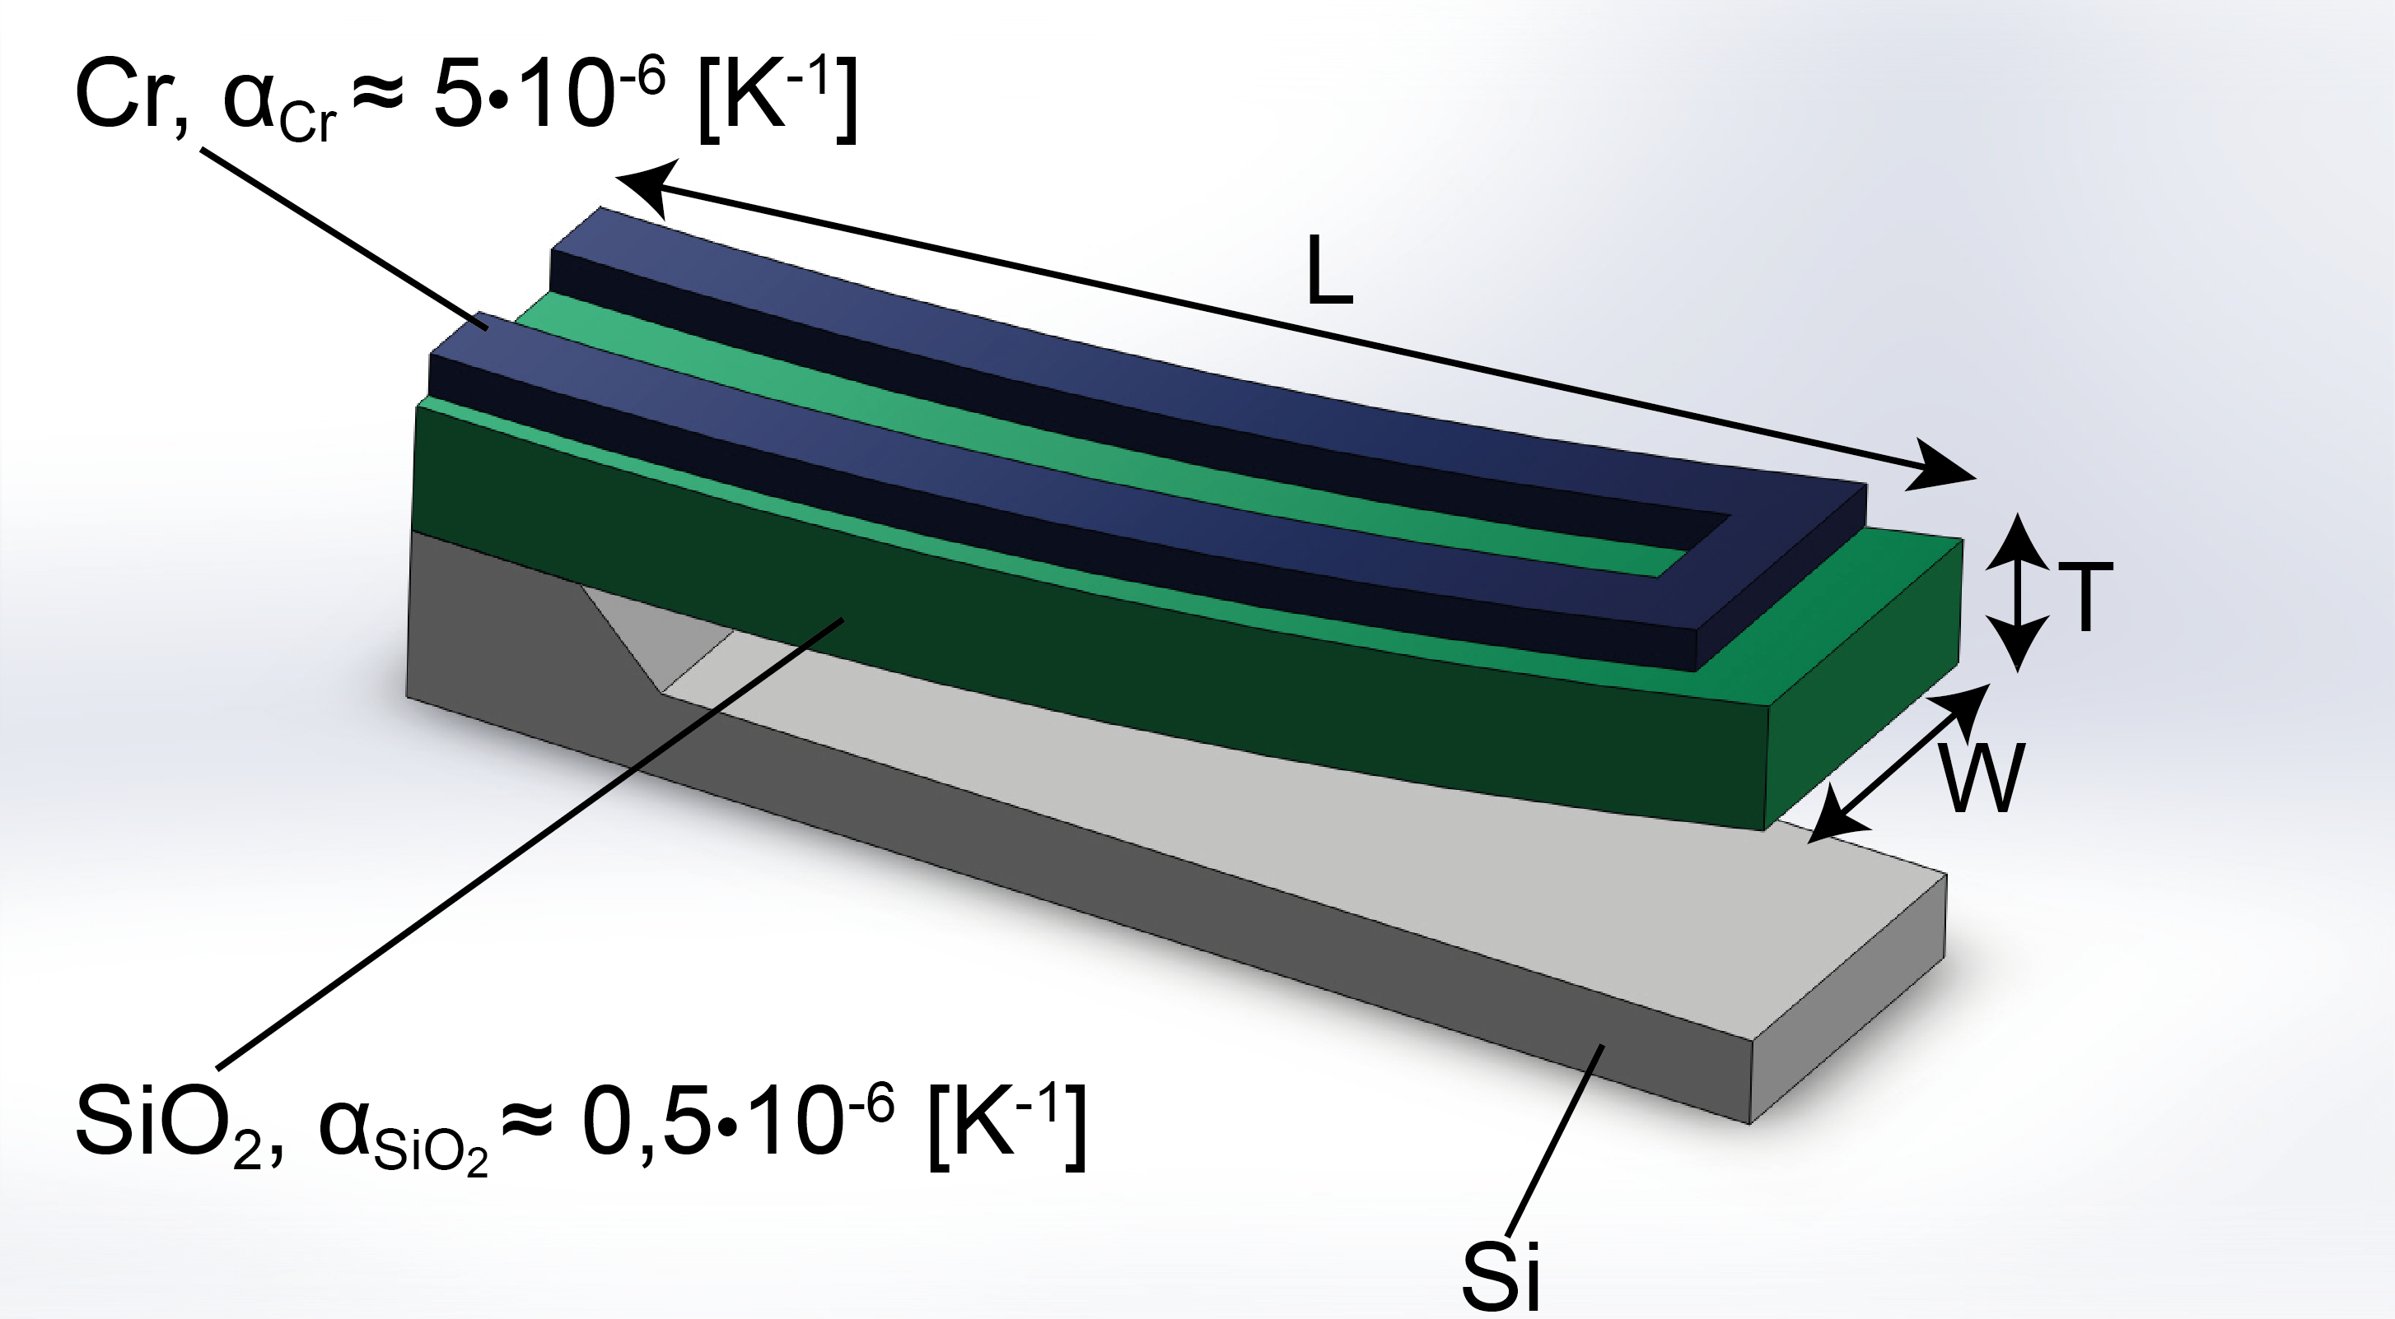
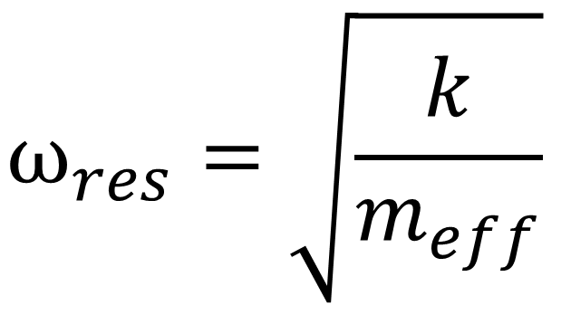
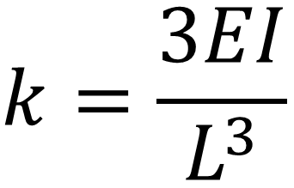
Scaling bi-morph to the micrometer
Thin films (SiO2 & Cr)
Applying voltage to Cr wire
Joule heating
Thermal expansion
Bending the cantilever
k: spring constant [N/m]
E: Young’s modulus [N/m²]
I: area moment of inertia [m⁴]
L: length of the beam [m]
ω_{res}: resonant angular frequency [s-1]
m_{eff}: beam effective mass [kg]
Notes:
Now let’s have a closer look on a device at the micrometer scale. (add scale bars, L, w, t, add alpha values, write k and f equation.)
In our example we study the case of a bi-morph cantilever that is made of two particular materials: silicon dioxide (or SiO2) and chrome (Cr). On the right side you see a 3D schematics of the device. A suspended SiO2 cantilever beam with a pattered Cr resistive electrode is attached to a silicon substrate.
When a voltage V is applied at the two extremities an electrical current I passes through the Cr pattern. Due to the electrical resistance R of the thin Cr film, Joule heating occurs which rises the temperature of the suspended SiO2/Cr cantilever. Since the Cr film is defined on a thin freestanding SiO2 beam with low heat sink capacity, the bi-morph can be heated to very high temperatures. Cr and SiO2 have very different thermal expansion coefficient, and thus the cantilever beam starts to bend.
Please note, that due to intrinsic stress gradients in grown or deposited thin films (SiO2 and Cr) there is already an initial bending at room temperature. This is often the case when films are grown at high processing temperature. How to control this stress is a subject of ongoing intensive research in surface engineering and will be touched upon later in the thin film chapter.
This slide also lists on the bottom the basic parameters that define the mechanical properties of the cantilever. The spring constant k can be calculated as follows: [handwriting] and the resonance frequency can be written as w = [handwriting]. To be accurate, one has to compute the spring constant k and the resonance w by taking into account that there are two materials involved. Since the Cr is a very thin layer compared to SiO2, it can also be neglected at first order approximation. There are analytical methods allowing taking into account the Cr layer.

Slide 4
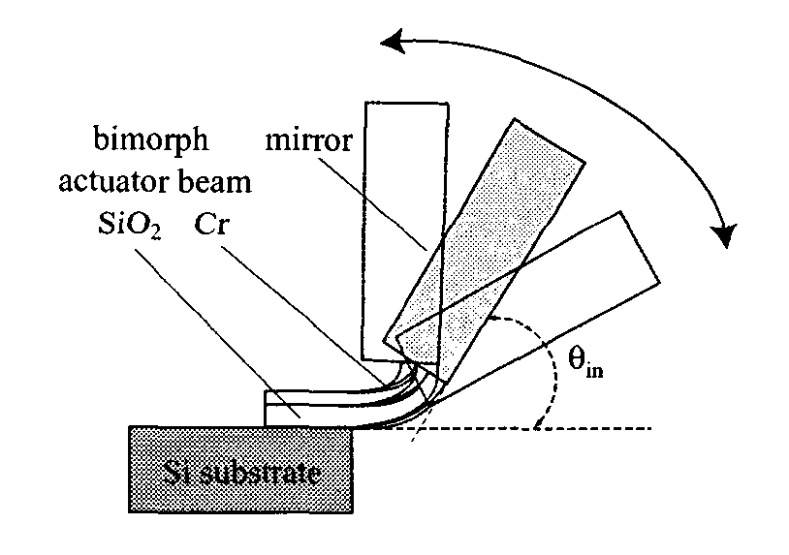
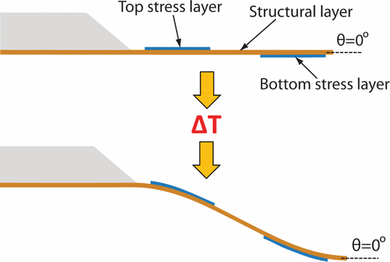
Applications of bi-morph micro cantilevers
Optical beam manipulation
  Switching and scanning of light
  Laser beam printers, barcode readers, optical sensors
AFM cantilever actuation
  Positioning and scanning of cantilever
  Tip height and contact force control
Pros: high amplitude and force ratio
Cons: power dissipation and dynamic range
PhD
S. Schweizer EPFL (2001)
PhD
J. Henriksson
EPFL (2015)
Notes:
Here are two examples shown where the bimorph cantilever has been developed for applications. The first example is a micromirror that can be used for steering and controlling optical beams. This device can be used in applications such as laser printers, barcode readers and optical sensors, to name a few.
The second example is a bi-morph cantilever for Atomic Force Microscopy (AFM). One way to speed up the imaging throughput of scanning nanoprobes is to use parallel AFM probes. In that case, it will be needed to control individual AFM probes to adjust for their respective tip height and applied surface force. The example shows a bi-morph cantilever that can be actuated up and down with high precision. In addition, the particular geometry with one bimorph layer on top and another on the bottom of the cantilever allows to flex the cantilever in a way that the angle of the cantilever front end remains horizontal.
In fact, the thermal actuator has very favorable scaling laws for miniature sensors and actuator applications, for several reasons. First, due to their small mass they can move relatively fast and are well suited for controlling optical beams, such as in micromirrors, microshutters, etc. It is in particular interesting where a large displacement range is required. Second, microfabrication techniques enables freestanding thin-film beams, also with integrated heaters. Drawbacks to be taken into account are the relatively high power consumption due to the joule heat dissipation, and the limited dynamic range.
Nevertheless, the bimorph actuator is a great demonstration example for microfabrication.

Slide 5
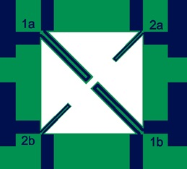
Preparation Session
1st theory session on Friday 07.03.2025 from 13h-15h :
  Answer the questions 1-5 available in the instructions on Moodle :
    Topic2-373-Instructions-Spring2025-V1.pdf
  Consult the references on Moodle, they can also help you.
By Tuesday 11.03.2025 13h
  Verify if you can run Klayout your computer
  Submit a short report with your answers to the questions 1-5 to chenxiang.zhang@epfl.ch
2nd design session on Friday 14.03.2024 from 13h-15h:
  Feedback on your answers provided during the lesson
  Design of the cantilevers using Klayout, including a funcy design!
  Simulation of the KOH etching with ACES
By Tuesday 18.03.2024 13h, submit your ACES simulation results and design file .gds to chenxiang.zhang@epfl.ch

Slide 6
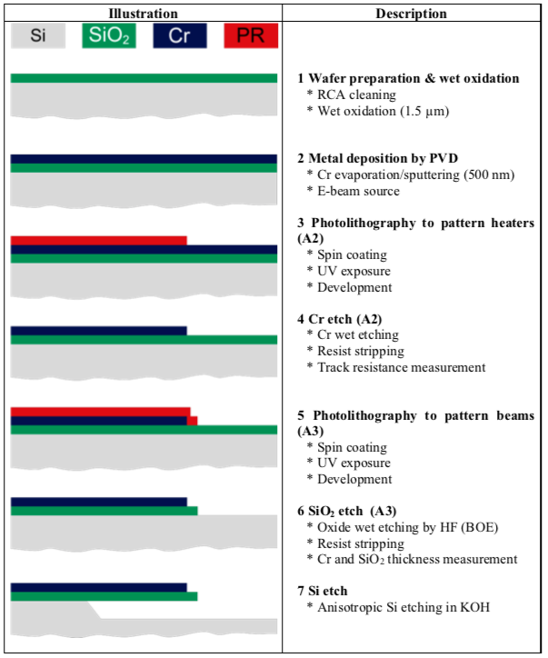
Fabrication Sessions
Fabrication of the cantilevers in the clean room
  Refer to the schedule of the class to know your date/TA
  Read the safety instructions to work in the clean room before your session
    Safety and Behavior in the Cleanroom_15BM+1 TP's.pptx
  The instructions file explains the full process
    Topic2-373-Instructions-Spring2025-V1.pdf
    There are questions for you to answer part Q1-Q15 for sessions 3-4 and Q16-Q30 for during the clean room sessions 5-7
  The process flow file reports the global steps to be done
    Topic2-373-TP-process-flow.pdf
  The runcard file contains the machines and parameters used
    Topic2-373-Runcard_Spring2025_v1.pdf

Slide 7
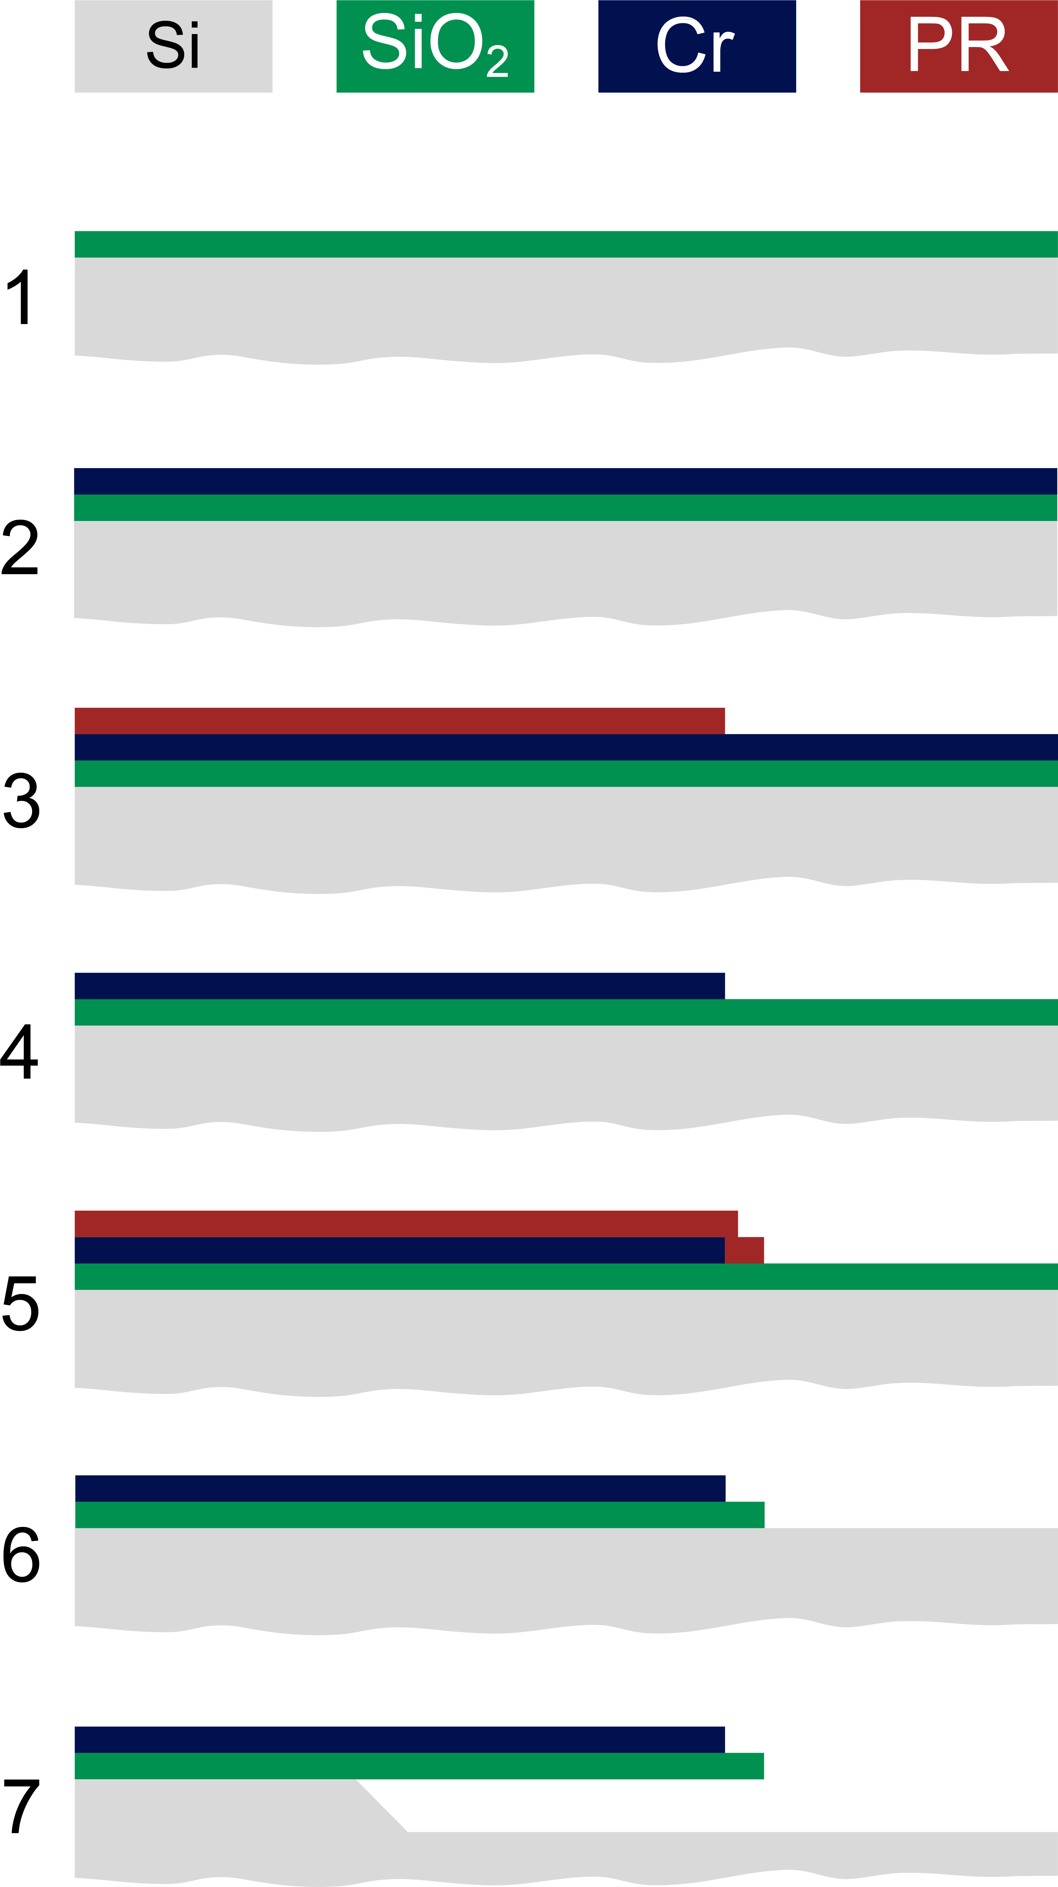
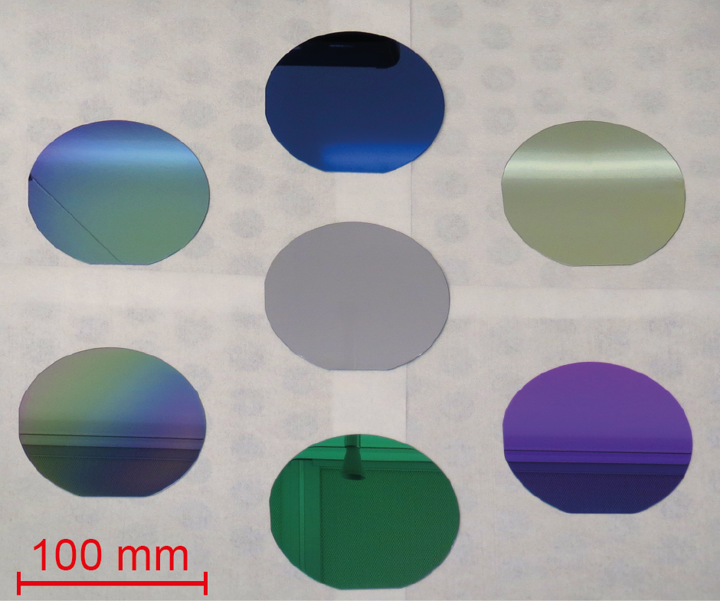
Step 1: Wafer prep and wet oxidation
RCA cleaning
Wet oxidation (1100C,1.5 μm)
100 nm
200 nm
10 µm
No SiO2
2 µm
500 nm
1 µm
Notes:
Step 1 of our case study microfabrication process for the bimorph is to clean the wafer for the thermal growth of a silicon dioxide layer, which will be one of the two bi-morph materials. A typical process for this purpose is called RCA cleaning, which is an industry standards since the 1960’s and consists of a couple of fabrication steps as shown in the accompanying documents.
The cleaning is needed to remove all dust particles and contamination film from the surface.
Wet oxidation is then carried out at very high temperature in a furnace with oxygen rich atmosphere. Silicon on the surface is thereby transformed into a SiO2 layer that growths with time while consuming the underlying silicon. Growing SiO2 layers follow the diffusion law.
Please to not mix up the thermal oxidation shown here with the deposition of SiO2 by PVD or CVD techniques. PVD and CVD are additive techniques, whereas thermal oxidation also consumes the substrate material and thus growths also into the silicon wafer. This will be explained later in detail.
To form a 1.5 um thick SiO2 we typically oxidize the silicon wafer during 6 h at 1100 deg C ?
On the right side you see 7 silicon wafers that are 4 inch or 100mm in diameter.
The wafer in the center is the initial silicon wafer that has a grey color. The other substrates are sliicon wafer with different SiO2 film thickness appearing with different colors. These colors appear due to interference effects as soon as a thin dielectric film, that is optically transparent, is grown on a reflective surface. Here we show you various silicon wafers with different SiO2 thickness (100nm, 200nm, 500nm 1um, 2um and 10um). By experience one can actually indicate roughly the thickness of the film by the color. To measure precisely the thickness however, an ellipsometer is needed.

Slide 8
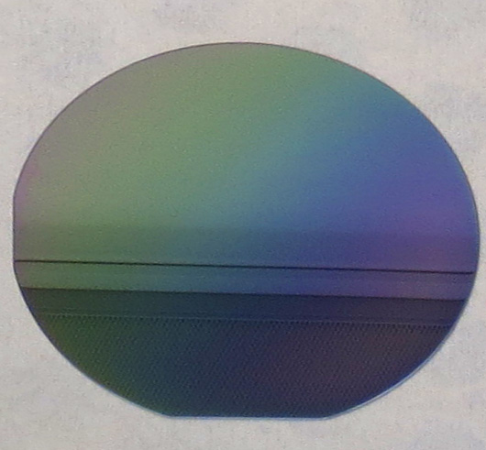
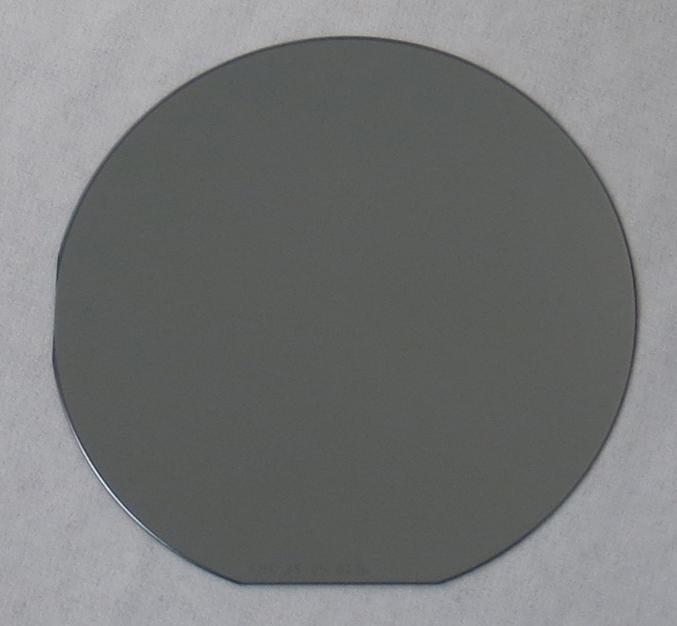
Step 2: metal deposition by PVD
Physical vapor deposition (high vacuum)
Cr thickness: 500 nm
E-beam source
Silicon dioxide
Chromium
Notes:
Step 2 is the physical vapor deposition (PVD) of the Chromium (Cr) layer which is the second material in the bimorph cantilever configuration. This layer serves several purposes: first, as thin conductor it will allow driving a current to heat up the surface that will result in the bi-morph actuation. Second, Cr is chosen before other metals, because it has a very different thermal expansion coefficient than SiO2. This mismatch will induce a very pronounced bi-morph effect. In this particular case we deposit a 500-nm-thick Cr layer by using one of our electron beam evaporator PVD system. The two photos show the silicon wafer with the 1.5um thick SiO2 on the left and after the 500-nm-thick Chrome layer deposition on the right hand side.

Slide 9
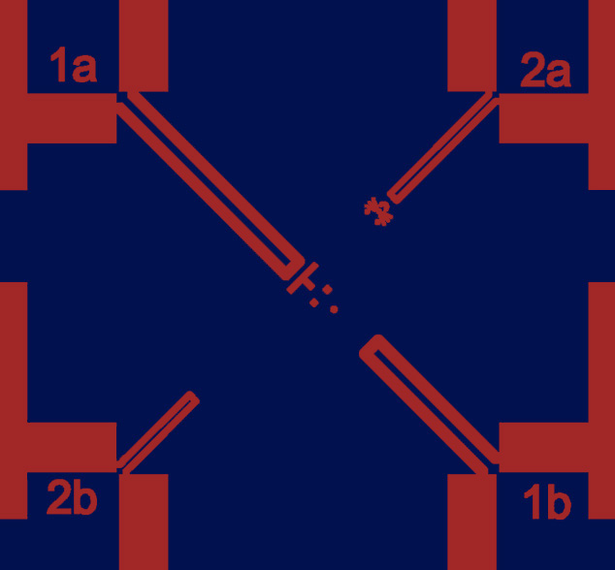
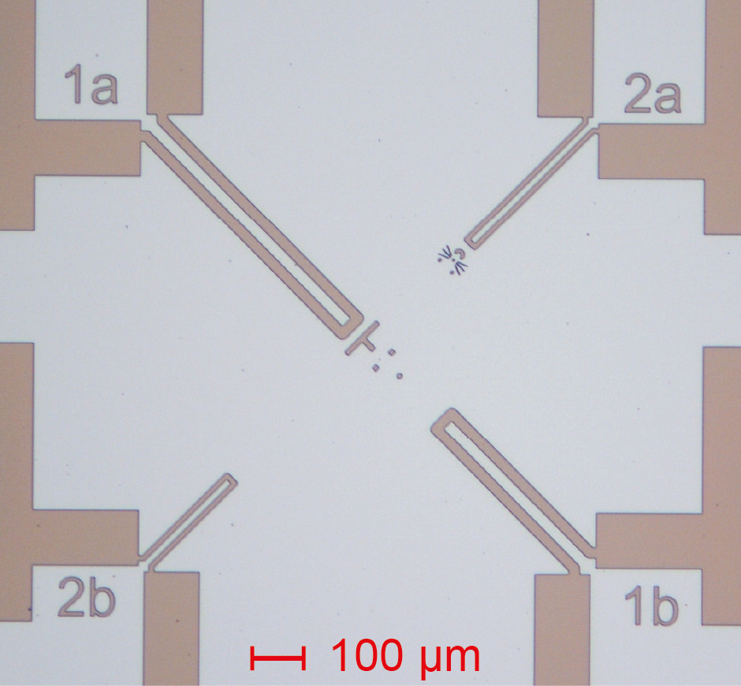
Step 3: Photolithography to pattern the heaters
Spin coating of photoresist
UV exposure through mask
Development
Design
Fabricated result
Notes:
Step 3 shows the first photolithography step. Here the goal is to pattern the Cr layer into micro-heaters that are later used to heat up the cantilever to induce bending. Photolithography is the process step that creates a pattern in a photoresist by local illumination through an exposure mask. How the photomask is created will be discussed later. The exposed resist is then developed, and the remaining resist pattern serves as etch mask to protect the underlying material from being etched. In the two graphics we can see on the left side the CAD layout of the Chrome layer design. The right side shows an optical photograph where we see the patterned photoresist that is slightly darker, on top of the Cr film that is still intact.
In the next step we will etch the Cr and see for the first time a real microstructure in a thin film will appear on the wafer, which is always an exciting moment for every student and researcher.

Slide 10
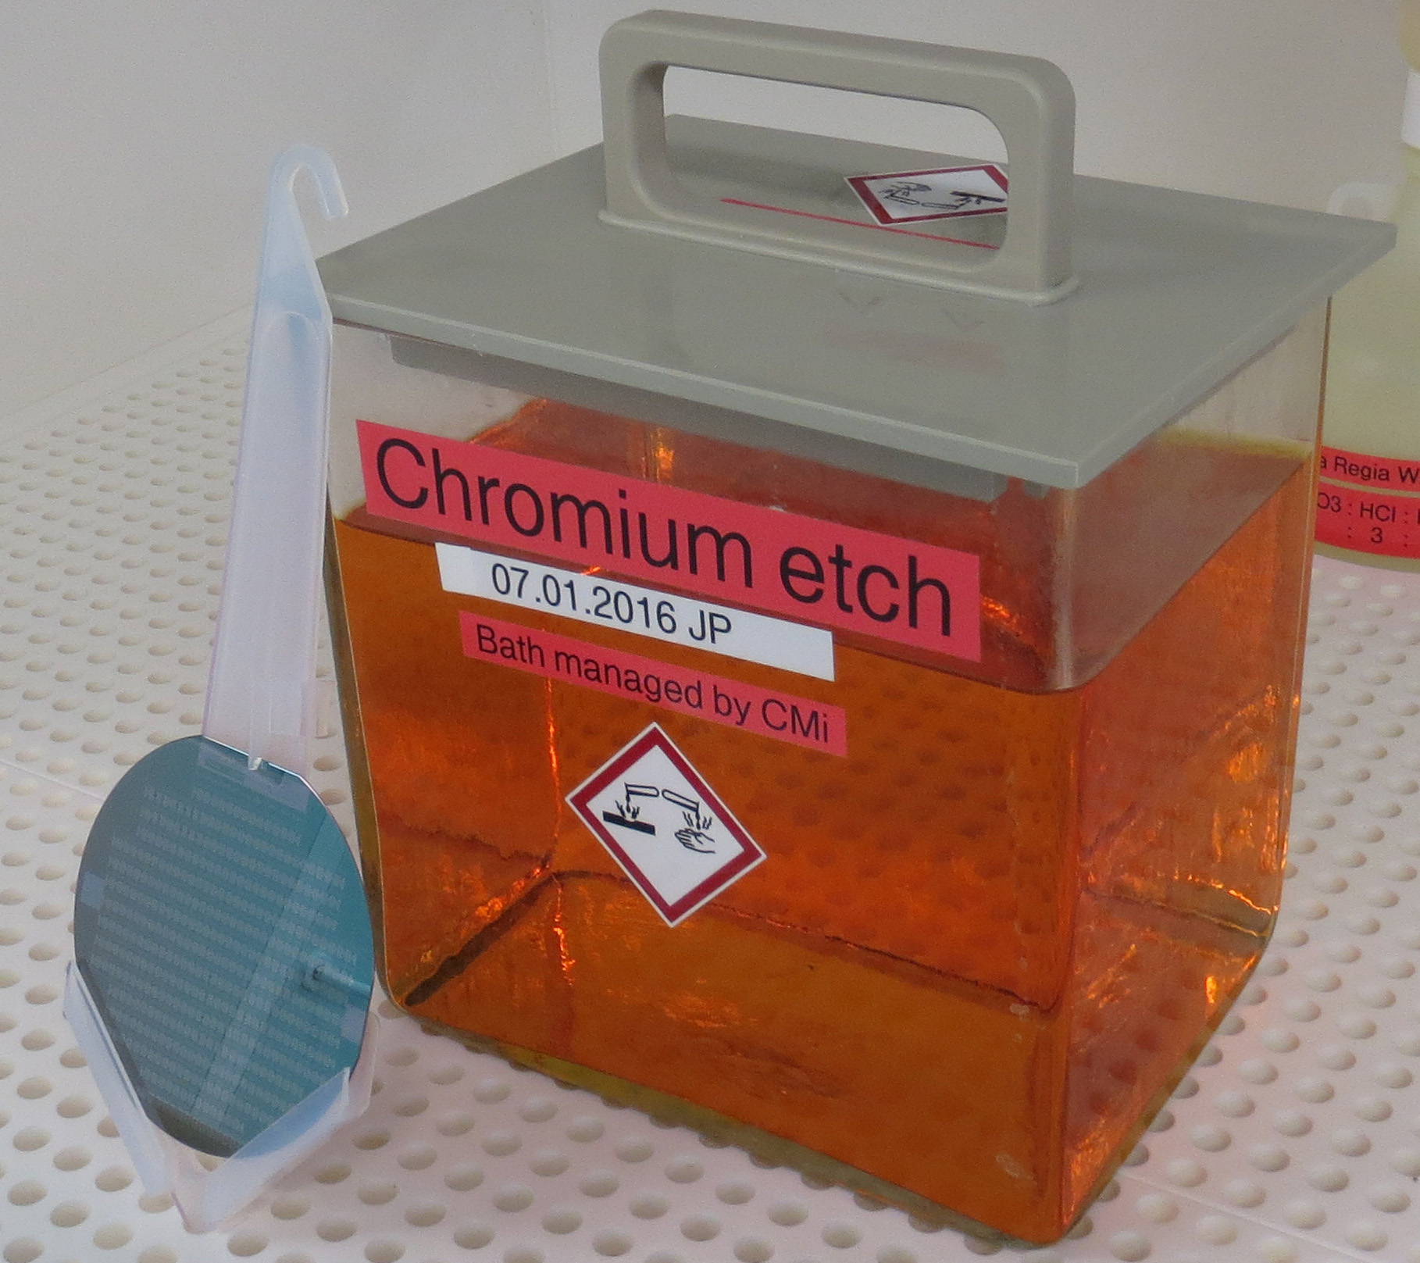
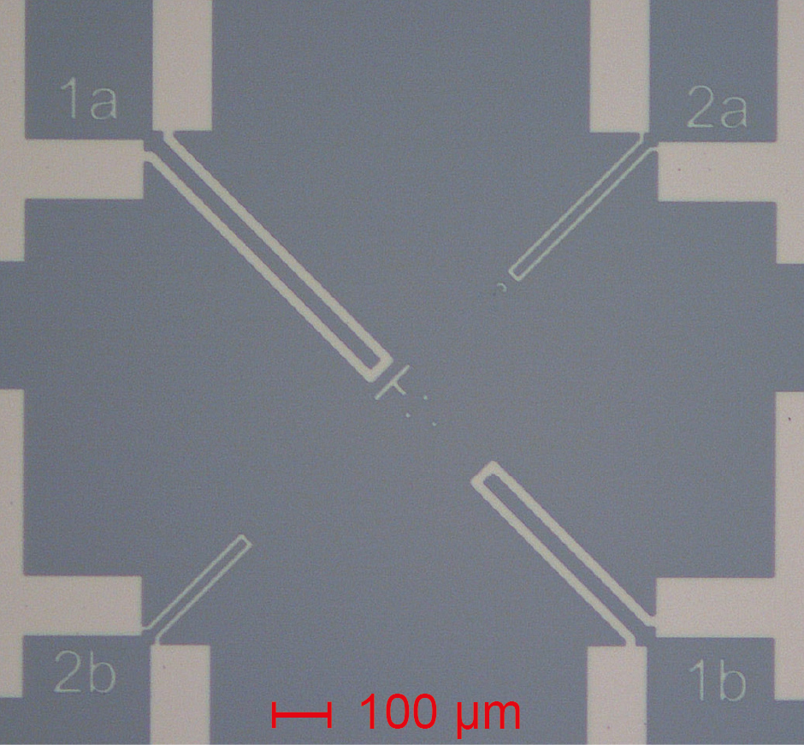
Step 4: Chrome etch
Cr wet etching
Resist stripping
After lithography
After Cr etching
Notes:
Once the photoresist is patterned by the photolithography step, we can now etch the Cr in step 4. Either dry etching by plasma or wet etching is possible. Here we show a simple wet etching method that does not require a sophisticated plasma tool. A convenient and well known Cr etch is a solution of Perchloric acid (HClO4) (6% wt.) and Ceric Ammonium nitrate ((NH₄)₂[Ce(NO₃)₆].) (9%wt) of striking orange color as shown on the upper right corner. The wafer with the photoresist pattern is placed into the Cr etch solution. Parameters to control are the etch rate (um/min) and the selectivity to the photoresist (which is almost infinite for this type of acid based wet etching).
After the Cr is completely etched through, a strong color contrast appears on the wafer. At this point, the photoresist is also removed by a so-called stripping process followed by thorough rinsing and cleaning. A careful inspection under an optical microscope shows the details of the micro-patterned Cr heaters. On the photographs we can see the quality of the Cr pattern on the SiO2 layer.

Slide 11

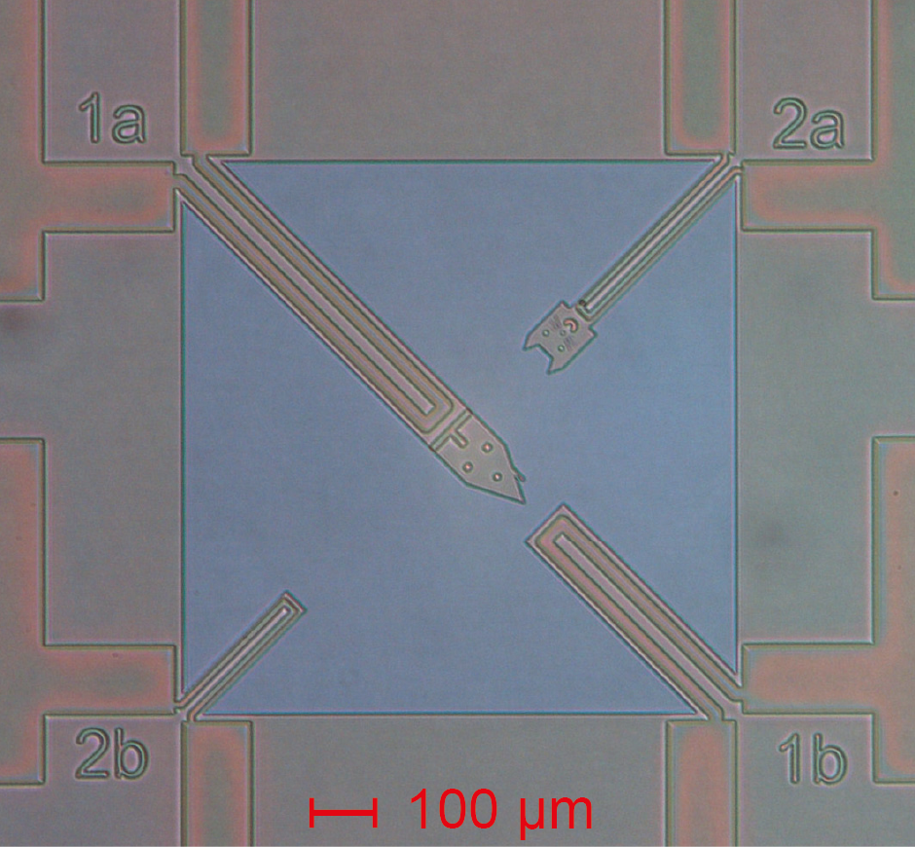
Step 5: Photolithography to pattern the beams
Spin coating
UV exposure
Development
Design
Fabricated result
Notes:
Step number 5 is the second photolithography that is used to pattern the layout of the free-standing SiO2 beam. It also serves to define the aperture for the anisotropic silicon etch to actually release the beam from the substrate by controlled underetching.
Like in the previous UV-lithography step, we start with a cleaning of the wafer surface, followed by spin-coating of the photoresist, associated temperature steps for pre-baking and solvent removal.
Then we align with micrometer precision the photomask on a dedicated mask aligner in the cleanroom to the previous layer and perform the UV exposure, followed by photoresist development. The corresponding pattern is shown here on the left with the CAD mask layout. The right hand side shows the zoomed optical photo of one particular device. One can see clearly the two layers now, the shape of the cantilever in photoresist defined in this second lithography, and the Cr that was defined in the first lithography step and that can be seen through the transparent photoresist. This allows checking that the alignment of the masks is within the tolerance specification.

Slide 12
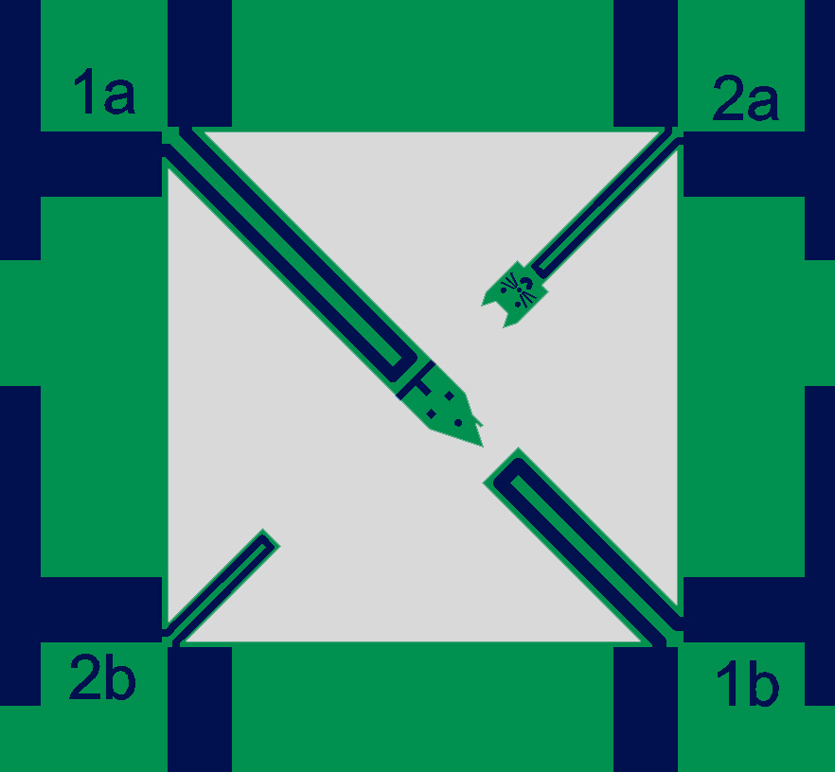
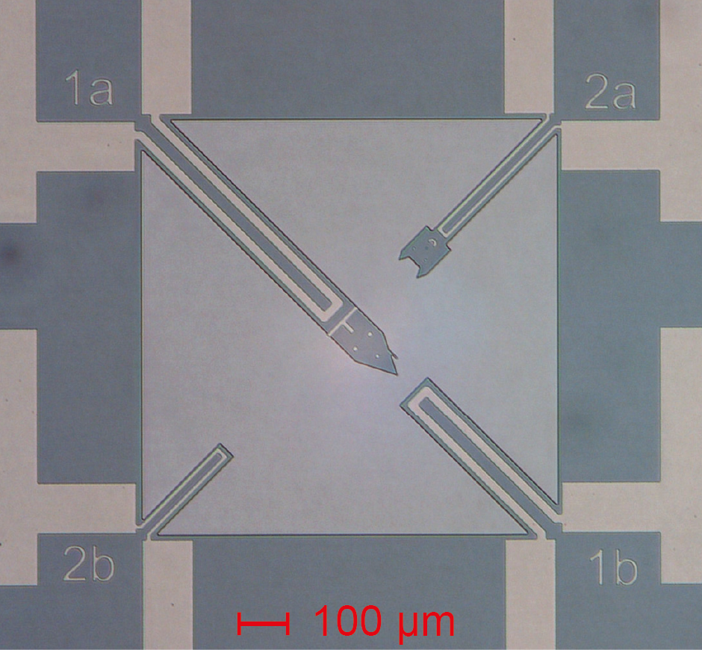
Step 6: SiO2 etch
Oxide wet etching by HF
Resist stripping
Careful !
HF is dangerous !
Design
Fabricated result
Notes:
In Step 6 we use the photoresist protection pattern from Step 5 to locally etch the SiO2 layer. Here we use buffered hydrofluoric acid (BHF). This etchant has a SiO2 etch rate of about 80nm/min. The etch selectivity between SiO2 and Si almost infinite. Thus, for etching the 1.5 um thick SiO2 we typically need about 20 min etch time, which stops naturally at the silicon surface.
Be cautious: BHF is very dangerous and strict safety measures have to be applied.
After the SiO2 etch, the photoresist can be stripped, exposing again the Cr layer. Please note, during the BHF etch, the Cr layer was completely covered by the photoresist and is thus not affected by the BHF solution.

Slide 13
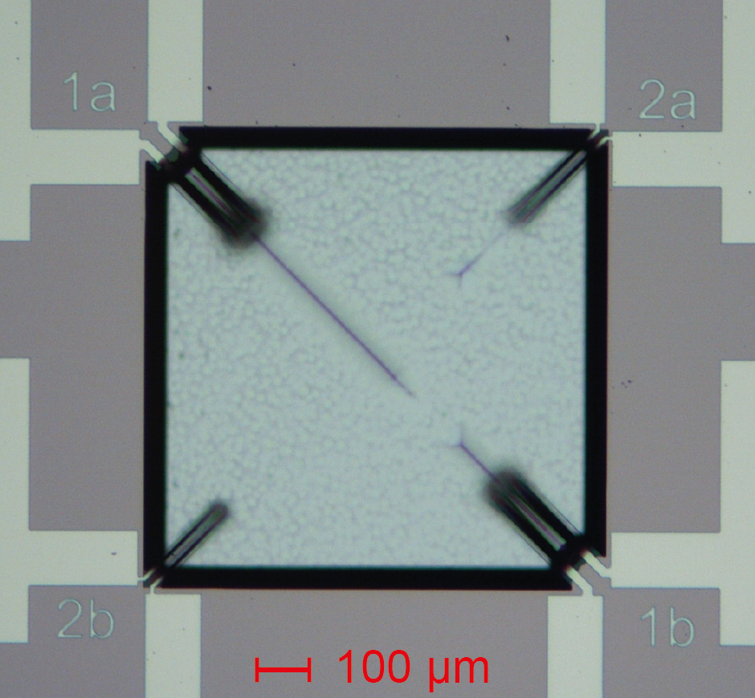
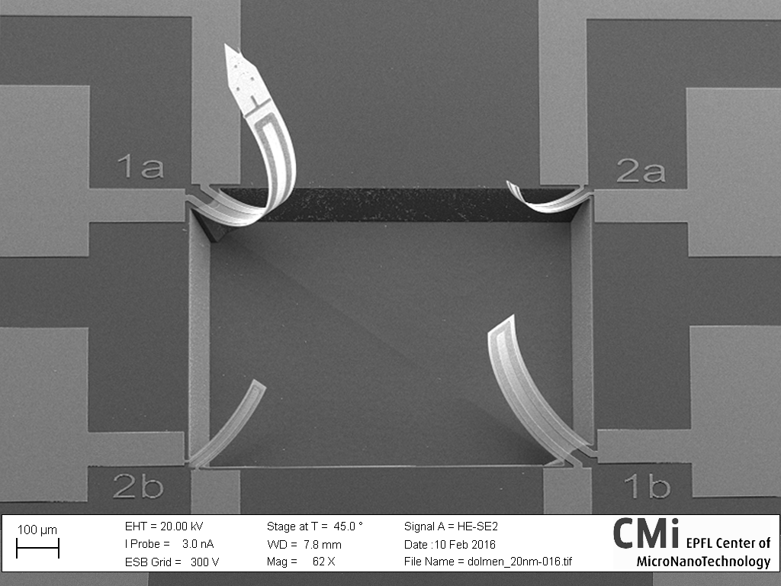
Step 7: Silicon etch
Anisotropic Si etching in KOH
Beams are released
Optical microscope
SEM image
Notes:
The final step 7 in this example process for a bimorph is the step that releases the cantilever beam from the underlying silicon by anisotropic underetching.
While there are several options that can be used to etch silicon, such as dry plasma silicon etching, we introduce here the anisotropic wet etching of silicon done in potassium hydroxide (also called KOH). This method is very versatile, and widely used for this type of structures.
The silicon <100> plane has an etch rate of about 20um/hour in KOH at 40% and 60°C, whereas the <111> silicon planes are nearly not etched at all, which allows creating the well defined 3D etch structure in the shape of a truncated inverted pyramid. The SiO2 layer thereby serves as etch mask to define the borders of the etched structure. With the largest cantilever being ~ 80 um wide we need about 2h to underetch 40 um from each side.
When the underetching is completed and the cantilever released from the silicon, the intrinsic stress in the SiO2/Cr sandwich layers induces the out-of-plane bending of the cantilevers. Here, on the right side you can see four levers with different geometries, numbers 1a, 1b, 2a and 2b to display the various final shapes that can be made after the fabrication process is completed.

Slide 14
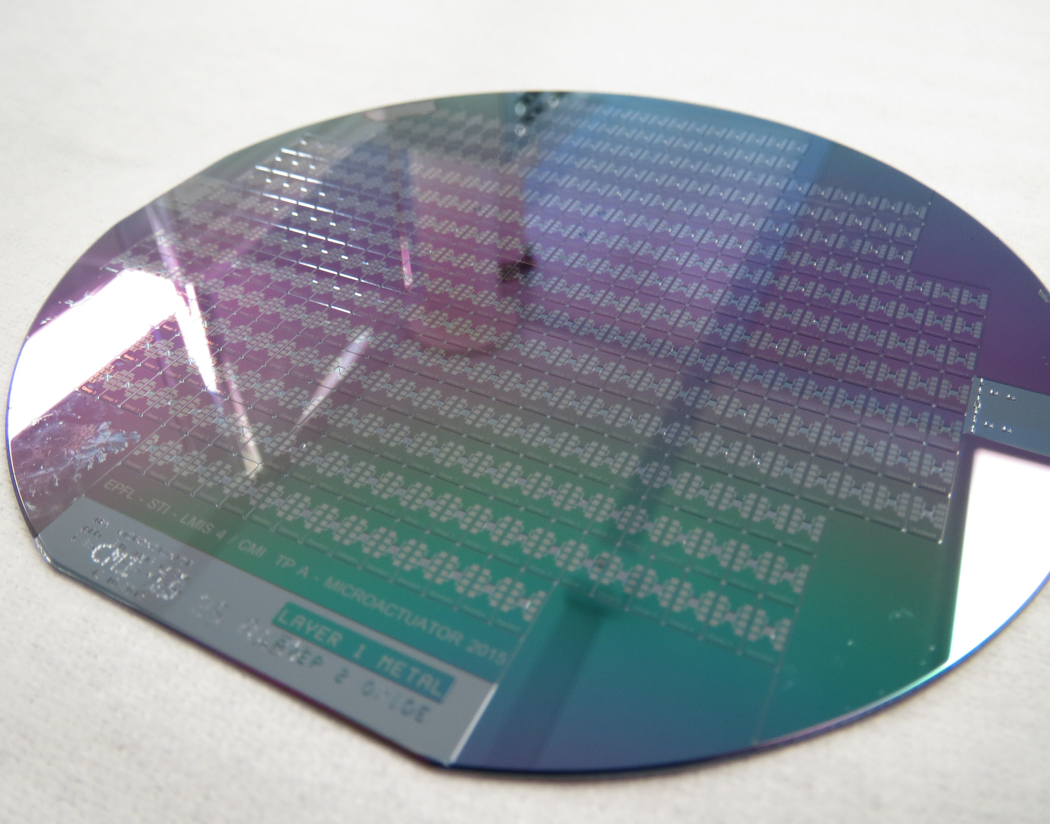
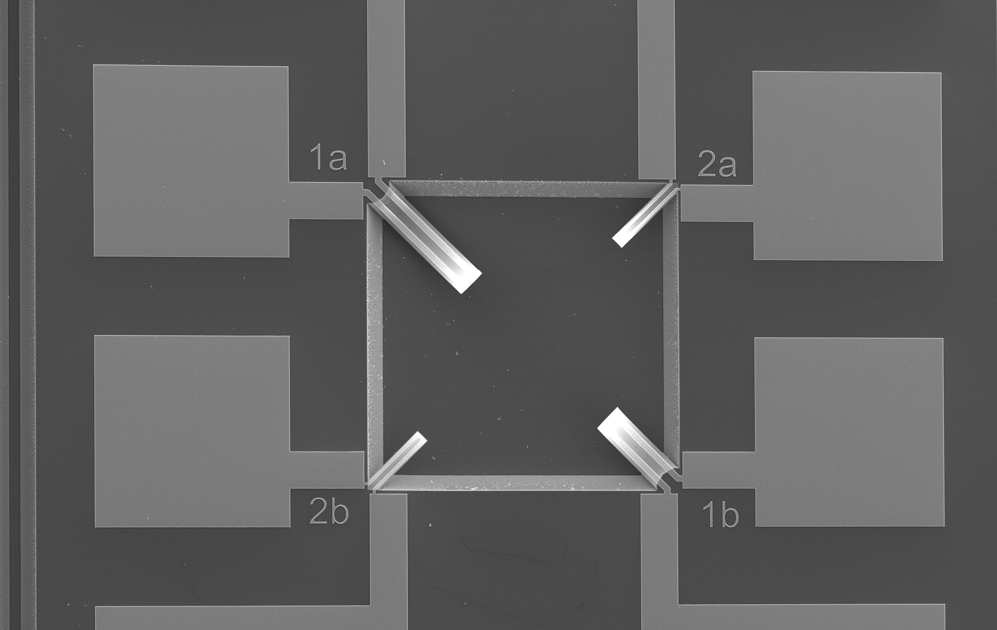
Full wafer after finished bi-morph microfabrication
Notes:
The photo on the left shows a full wafer after the fabrication is concluded. It contains hundreds or bimorph devices that are now ready for testing.
A zoom using a SEM shows the details of 4 bimorph cantilevers with different geometries.
A further zoom shows details of one particular device nicely showing the Chrome pattern on top of the SiO2 cantilever.
Remember that the bending at this stage is due to intrinsic stress as result of the fabrication process.

Slide 15
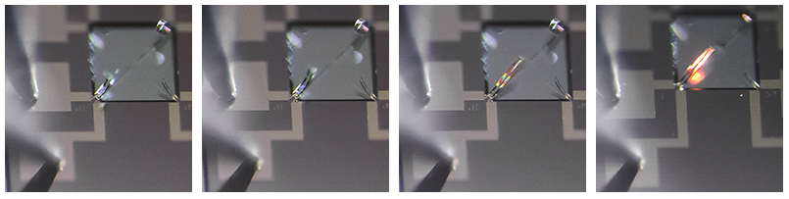
Characterization session
Characterization of the cantilevers
  In the LMIS1 lab
  See the schedule to know your date/TA
0
DC current [mA]
120

Slide 16
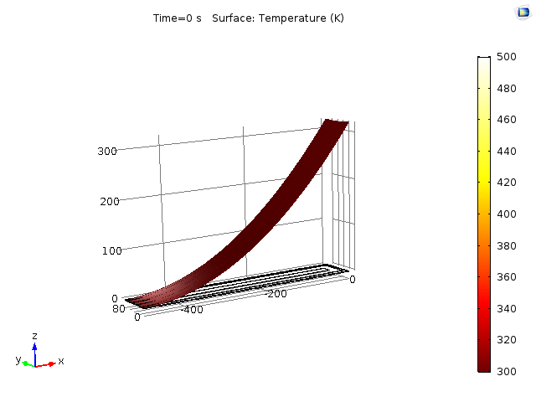
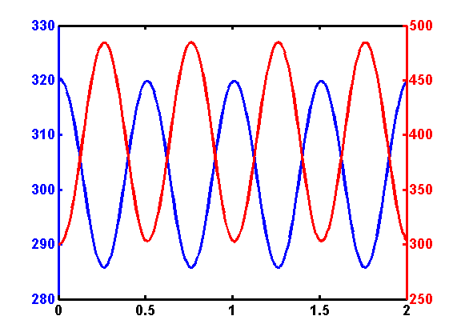
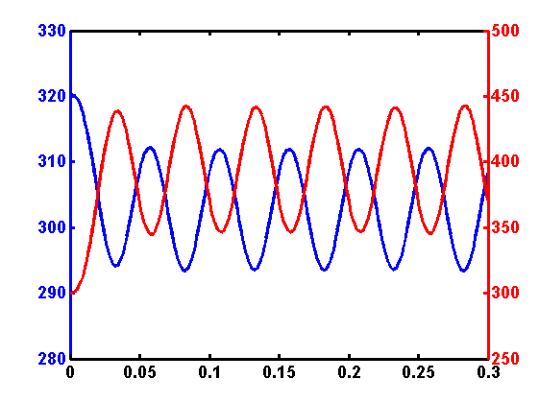
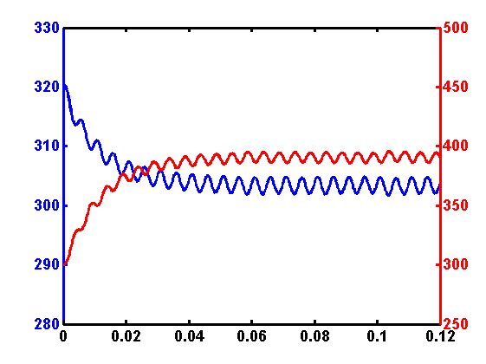

Thermo-mechanical characterization
Dynamic [FEM simulation] using COMSOL
  AC current in Cr track
  Oscillation frequency is twice that of the AC frequency
  Increasing frequency reduces the amplitude
Displacement [µm]
Temperature [K]
1 [Hz] excitation current
10 [Hz] excitation current
100 [Hz] excitation current
Displacement [µm]
Displacement [µm]
Temperature [K]
Temperature [K]
Displacement [µm]
Temperature [K]
Time [s]
Time [s]
Time [s]
Notes:
Now we will test the dynamic properties of the bimorph. To this end we apply an AC voltage. We know for instance that the beam has it’s own mechanical resonance frequency, which is ~7 kHz for the large beam and 18 kHz for the short beam, respectively.
Oscillation frequency is twice the current frequency. We also know that the heat dissipation of the device has a certain bandwidth. By increasing the frequency of the voltage pulse, we can determine at which frequency the heat can not be dissipated anymore and will consequently keep the beam at a constant temperature. . => Increasing frequency leads to smaller oscillations (because of poor heat dissipation and also because of mechanical stiffness)…
Here we can see that when increasing the frequency, oscillation amplitude is smaller and beam is not completely cooling between each oscillation

Slide 17
Final report
Submit the final report and all the related files on moodle 1 week after your last TP session
  Guidelines for the submission of the report are available in the instructions
You’ll be able to request a feedback when all the reports are corrected at the end of the semester

Slide 18
Before the theory session
1) Verify if you can run/use Klayout (Windows, MacOS, Linux) on your computer and ACES (Windows only, only 1 student per group will need to run it). Let us know if you have any software issue or if everything runs well.
2) Answer the preparation questions 1 to 5 in a short .pdf report (file name should be "Topic2-373-Preparation_Group#_Name1_Name2_Name3.pdf". Replace # by the group number and Name1, Name2, Name3 by the names of the people in the group).
→Perform tasks 1 and 2 and submit your .pdf report to chenxiang.zhang@epfl.ch until Tuesday 11 March 13h. You'll get feedback during the next session.

Slide 19
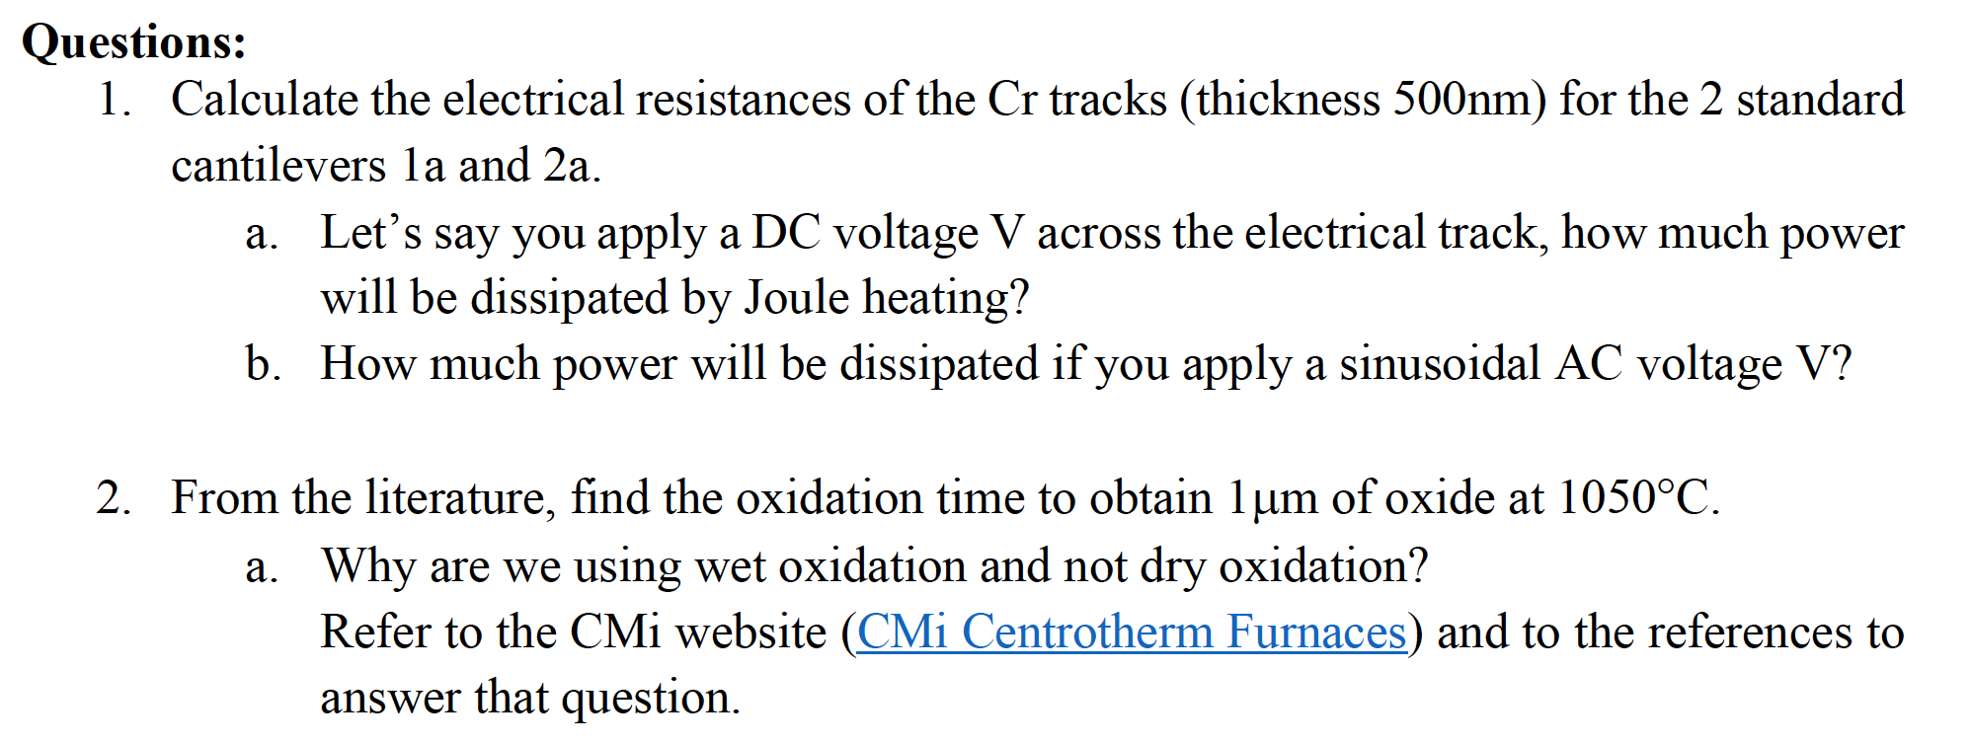
Theory

Slide 20
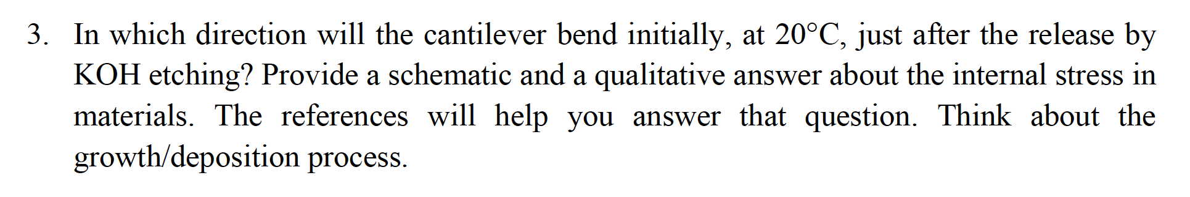
Theory

Slide 21
Questions session - Hint
Question 3
  Think about the thermal stress, the thermal expansion coefficients of the materials and the deposition conditions
⍺_{Si}~2,6*10^⁻⁶ [K⁻¹]

Slide 22
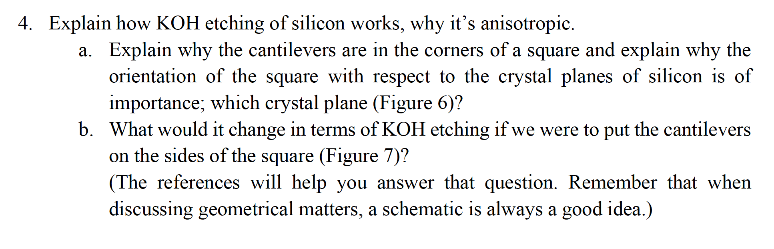
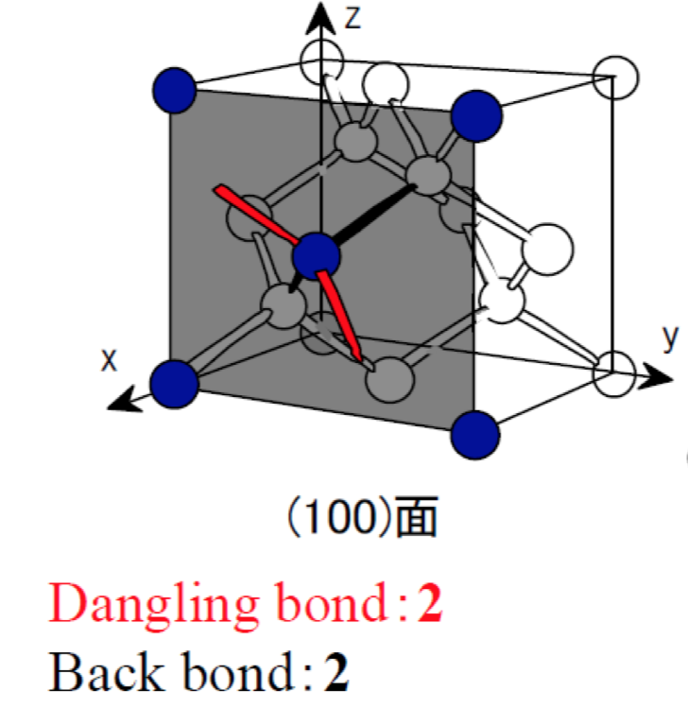
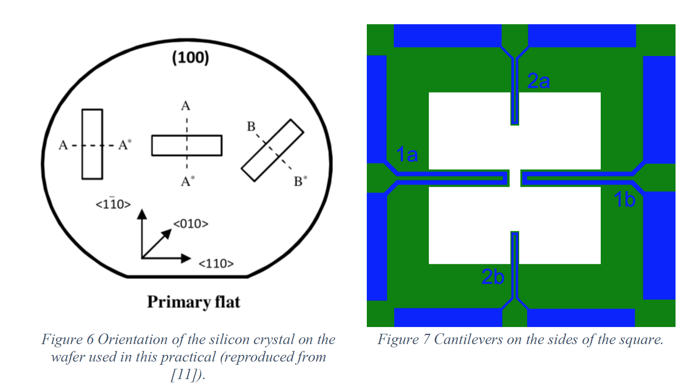
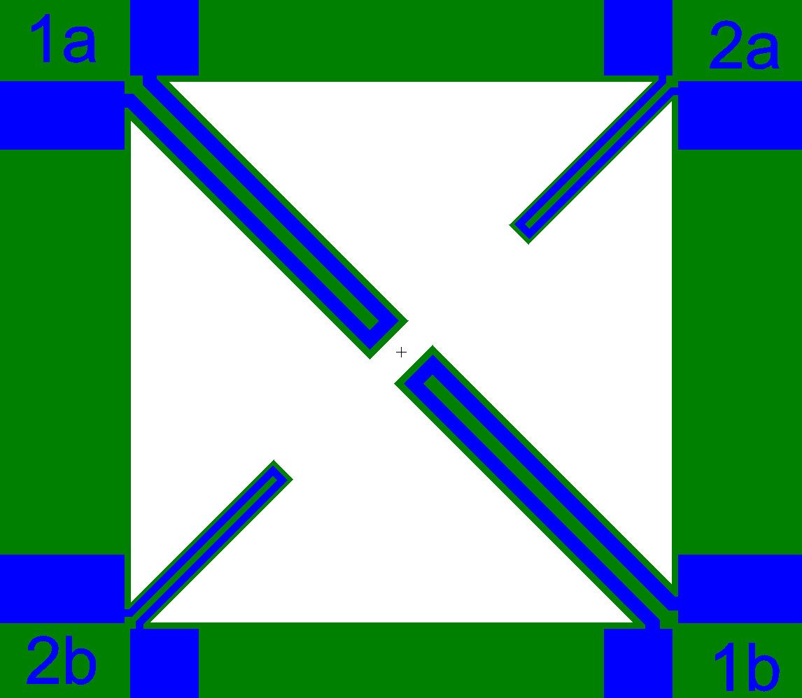
Theory
Notes:
https://nanohub.org/resources/25355/download/2016.04.13-ECE695Q-L44.pdf

Slide 23
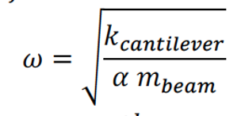
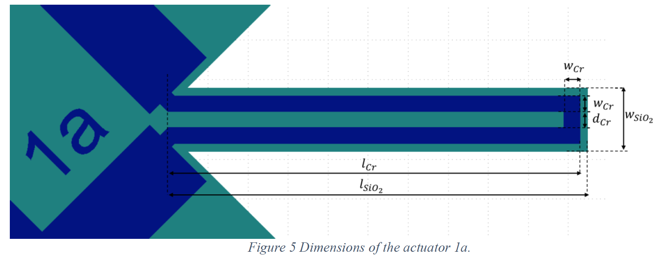
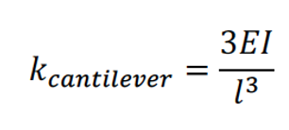
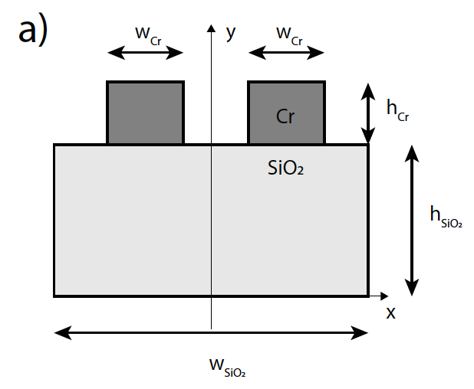
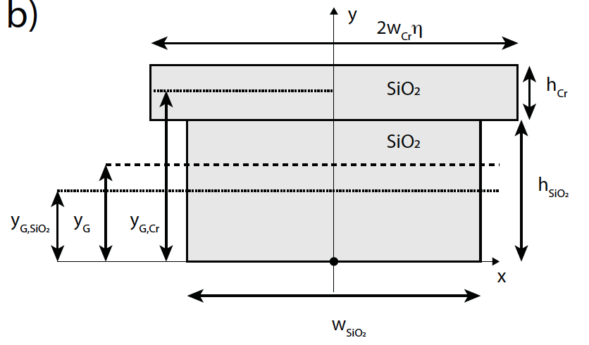
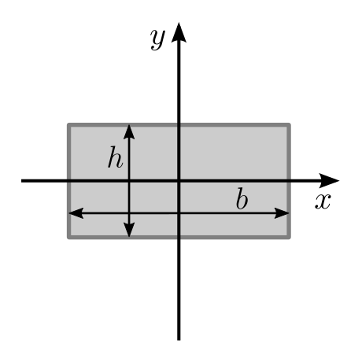
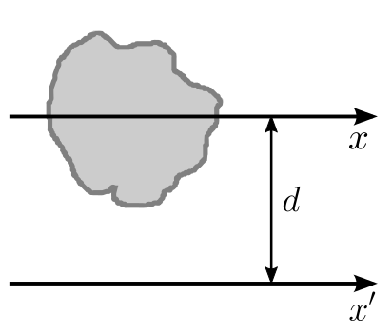
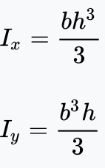
Theory – question 5
➔ Estimate the resonance frequency of both standard micro-fabricated cantilevers 1a and 2a (see design in Figure 5).
To do so, use the formulas below.
An approach you can follow consists in transforming the 2-material structure into an equivalent 1-material structure as described in the section §9.1 Composite Cross-Sections of the reference [13].
You’ll also need to evaluate the total area moment of inertia for the two materials.
Report the total area moment of inertia I, the spring constant k, the mass of the structure m and the resonance frequency f.

Slide 24
Theory – test softwares for next session
Klayout – to design the cantilevers
  Install (Linux, MacOS, Windows)
  Open TP_A-Standard4.GDS
    Configure it in editor mode and try to add/delete/modify any feature
  ➔ Does it work?
ACES – to simulate the KOH etching process
  Install (Windows only)
  Download the folder ACES
  Run the executable ACES.exe
  ➔ Does it work?

